Slide 1
Introduction to R
Archana Naik

Slide 2
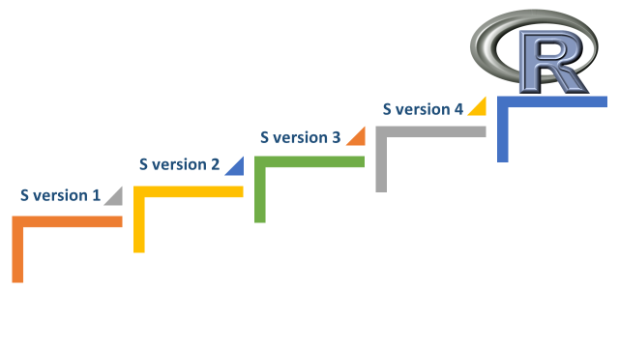
Origin in the Bell Labs in the 1970’s
S V1 | S V2 | S V3 | S V4
•FORTRAN based, via preprocessing tools • Only for our (bizarre) operating system • Adopted our existing graphics & data structure software | • Portability via a Unix implementation • Most features carried over from V. 1 • Device-independent graphics | • Merged some new ideas with S • “Everything is an object” (including functions) • No direct back compatibility with S2 | • ‘Computing with data’ distinguished from statistical computing • Extensions to the S programming model • Today we have the S language, implemented in R

Slide 3
HISTORY OF R
The R language is a terminology of S language which was designed in the 1980s by John Chambers at Bell labs and has been in widespread use in the statistical community since.
It was grown up by Robert Gentleman and Ross Ihaka of the University of Auckland. R has been with us since 1993.
After the four versions of ‘S’ language we came up with R Programming tool and R Programming language.
It is concluded to adopt the syntax of the S language which has developed at Bell Laboratories

Slide 4
The Development of R
1991: Created by Ross Ihaka and Robert Gentleman at the University of Auckland, New Zealand
1993: First announcement of R to the public.
1995: R was made as free software.
1997: The R Core Group is formed (containing some people associated with S-PLUS). The core group controls the source code for R.
2000: R version 1.0.0 is released.
2013: R version 3.1.2 has been released on 2014-10-31.
Latest version 3.4.1 released on 2017-6-30

Slide 5
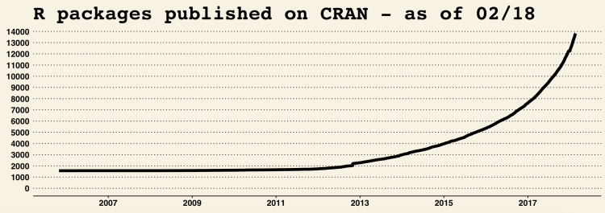
Contd…
Notes:
With 100 packages in 2001 , the number of packages available in CRAN is incresed to 4000+
ven if you just look at the standard R distribution (the base and recommended packages), R can do almost everything you require for Statistical Analysis, Data Manipulation and Visualization. And there’s 4000+ packages on CRAN and on other repositories.

Slide 6

Why R essential?
R provides you number of Datasets that can be used in Analytics and these datasets are built in and are available in packages
Time Series Data
Numeric Data
Categorical Data
Character Data
Small Data
Large Data

Slide 7
What is R?
R is rather a programming language
Limited user-friendly interfaces for data analysis
Is object oriented and almost non declarative
Similar to programming languages like Fortran, C, Java, Python
The source code for the R software environment is written primarily in C, Fortran, and R

Slide 8
Features of R
Provides Statistical and Graphical techniques
linear and nonlinear modelling
classical statistical tests
time-series analysis,
classification, clustering
Others
Available through additional packages
easily extensible through functions and extensions
C, C++, and Fortran code can be linked and called at run time
Object-oriented, growing user base, scripting features
Free and open-source

Slide 9
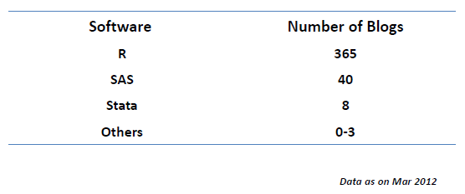
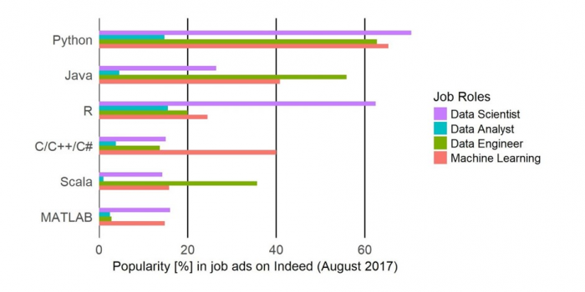
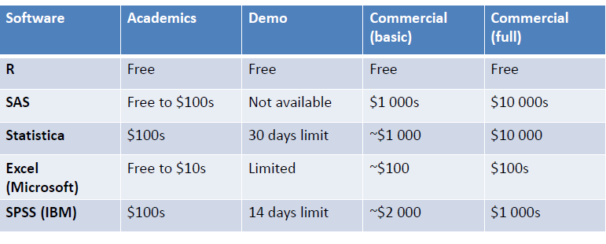
Popularity of R

Slide 10
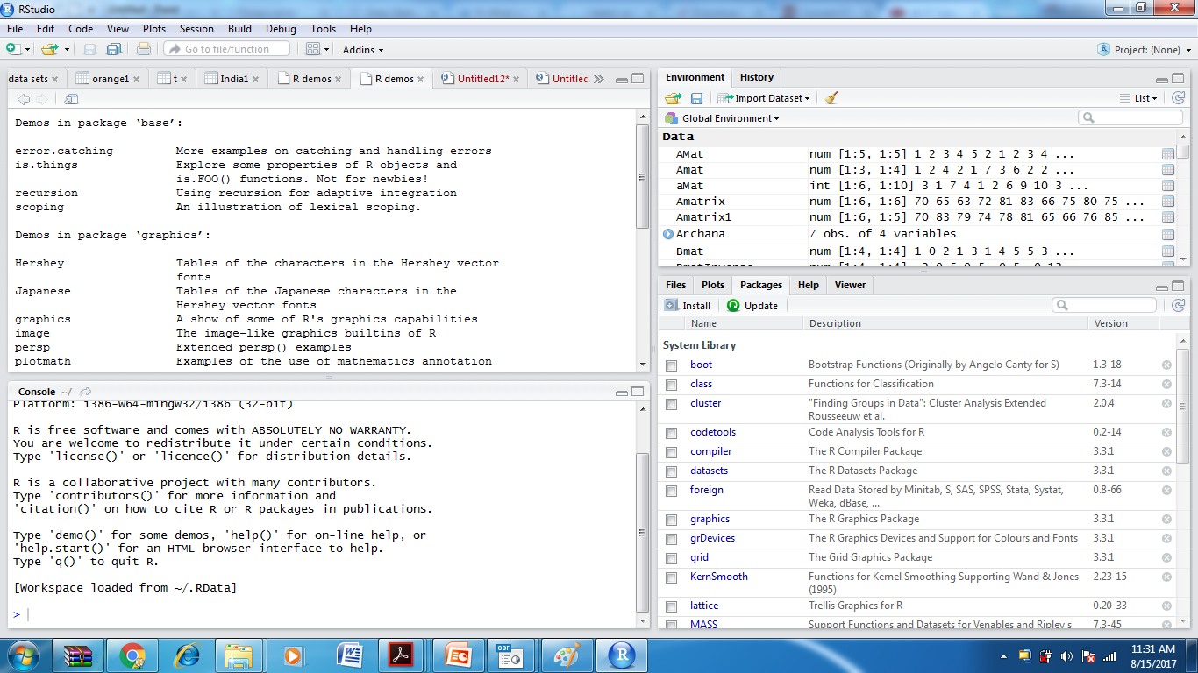
R Studio -IDE

Slide 11
Working with R
Download & Install R: http://www.r-project.org/
Download & Install R Studio:
Materials
https://www.r-project.org/

Slide 12
Basics
Basic Data types and how to create them
Operators and how to use them
Variable naming and how to create, manipulate and destroy
Every command types is an Assignment or an Expression
Notes:
y

Slide 13
Overview
R is functional language
Each command given on the command prompt is either
Expression
4 + 5
sqrt(30)
Assignment
X <- 4 + 5
56 -> Y
Functions
User Defined
Built in ( Take the help)
Variables
Similar conventions used as in other programming languages
Can be declared as and when required

Slide 14
1. Data Types
R calls data types /categorizes data types as classes
The variables are assigned with R-Objects and the data type of the R-object becomes the data type of the variable.
Frequently used data types in R are
Vectors
Lists
Matrices
Arrays
Factors
Data Frames

Slide 15
Data Types Contd…
Vectors
There are six data types of these atomic vectors, also termed as six classes of vectors.
The other R-Objects are built upon the atomic vectors.
Data Type | Example
Logical | TRUE, FALSE
Numeric | 12.3,5.0,0.999 | Numbers , including decimals
Integer | 12L | Integers
Complex | 5+9i | Complex()
Character | ‘a’, ’Hello’ | Data within the quotes
Raw | ‘Hello’ | Raw() – used to create Raw numbers are represented as a two digit sequence of hex numbers. Valid hex digits include 0 − 9 as well as a, b, c, d, e, & f.

Slide 16
Data Types Contd…
Constants
Name | Description
pi | Mathematical functions ¶
NULL | Absence of type
Nan | Not a Number
Infinity | ∞ as well as -∞
NA | Used to represent missing data
To create vector C() function is used

Slide 17
Data Types Contd…
Lists
can contain many different types of elements inside it like vectors, functions and even another list inside it.
>A= list(c(2,5,4), 21.4, 5+8i)
> print(A)
[[1]]
[1] 2 5 4
[[2]]
[1] 21.4
[[3]]
[1] 5+8i
(Vector all data are of the same data type, Lists store the data of different data types)

Slide 18
Data Types Contd…
Matrices
Matrices are 2-dimensional vectors
Created using the default constructor matrix() function
passing it a number for nrow and ncol
M = matrix( c('a','a','b','c','b','a'), nrow = 2, ncol = 3, byrow = TRUE)
> M [,1] [,2] [,3]
[1,] "a" "a" "b"
[2,] "c" "b" "a“
Default will be by column

Slide 19
Data Types Contd…
Arrays
Any numbers of dimensions
takes a dim attribute which creates the required number of dimension
To create array of 2X3, with elements 1,2,3, dimension 3 times
> A<- array(c(1,2,3), dim=c(2,3,3))
> A
, , 1
[,1] [,2] [,3]
[1,] 1 3 2
[2,] 2 1 3
, , 2
[,1] [,2] [,3]
[1,] 1 3 2
[2,] 2 1 3
, , 3
[,1] [,2] [,3]
[1,] 1 3 2
[2,] 2 1 3

Slide 20
Data Types Contd…
Factors
Used to categorize the data and store as levels
Useful in statistical modelling
> A<- c(2,3,5,34,3,2,56,34)
> Afact= factor(A)
> Afact
[1] 2 3 5 34 3 2 56 34
Levels: 2 3 5 34 56

Slide 21
Data Types Contd…
Data Frames
Same as Spreadsheet
Data frames are used to store tabular data
They are represented as a special type of list where every element of the list has to have the same length
Each element of the list can be thought of as a column and the length of each element of the list is the number of rows
Unlike matrices, data frames can store different classes of objects in each column (just like lists); matrices must have every element be the same class

Slide 22
Data Types Contd…
Example of creating Data frame
> id= c(1:4)
> Name= c("Asha","Geetha", "Rita", "Raj")
table1= data.frame(id,Name)
> table1 id Name
1 1 Asha
2 2 Geetha
3 3 Rita
4 4 Raj
Marks<<- c(25,28,30,22)
> (table1=data.frame(id,Name,Marks))
id Name Marks
1 1 Asha 25
2 2 Geetha 28
3 3 Rita 30
4 4 Raj 22

Slide 23
2. Operators
Arithmetic Operator (Numeric Operator)
+ Addition
- Subtraction
* Multiplication
/ Division
^ Exponentioation
Assignment Operator
->
<-
<<-
=
Relational and Logical Operator
>
<
==
!=
&
|
!

Slide 24
Operators Contd..
Special Operator
%% Mod operation
%/% Integer Division
%*% Matrix Multiplication
: To build sequence
%in% Value Matching

Slide 25
Functions/Commands
Command Purpose
help() Obtain documentation for a given R command
example() View some examples on the use of a command
c(), scan() Enter data manually to a vector in R
seq(f,t,by=b) Make arithmetic progression vector
rep(x,n) Make vector of repeated values
data() Load (often into a data.frame) built-in dataset
View() View dataset in a spreadsheet-type format
dim() See dimensions (# of rows/cols) of data.frame
length(x) Give length of a vector
ls() Lists memory contents
rm() Removes an item from memory
names() Lists names of variables in a data.frame
summary() Display 5-number summary and mean
Class() Returns the class/Data type
Paste(x,y) Concatenates x,y

Slide 26
Flow Control
If
If else
Continue
Break, Next
Switch
Repeat
For
while

Slide 27
If
if (test_expression)
{ statement }
2. If..else
if (test_expression)
{ statement1 }
Else
{ statement2 }

Slide 28
Nested if
if ( test_expression1)
{ statement1 }
else if ( test_expression2)
{ statement2 }
else if ( test_expression3)
{ statement3 }
else statement4

Slide 29
Break
A break statement is used inside a loop (repeat, for, while) to stop the iterations and flow the control outside of the loop.
Example
x <- 1:5
for (val in x)
{ if (val == 3)
{ break }
print(val) }
Output
[1] 1
[1] 2

Slide 30
For Loop
for (val in sequence)
{ statement }
Below is an example to count the number of even numbers in a vector.
x <- c(2,5,3,9,8,11,6)
count <- 0
for (val in x)
{ if(val %% 2 == 0)
count = count+1 }
print(count)

Slide 31
While Loop
while (test_expression)
{ statement }
Example
i <- 1
while (i < 6)
{ print(i) i = i+1 }

Slide 32
R Functions -1. Programming Function
func_name <- function (argument)
{ statement }
Example
pow <- function(x, y)
{ # function to print x raised to the power y
result <- x^y
print(paste(x,"raised to the power", y, "is", result))
}
>pow(2,3)
>8

Slide 33
Switch
switch (statement, list)
>switch(2,"red","green","blue")
> [1] "green"

Slide 34
R data interfaces
CSV file
Reading
data <- read.csv("input.csv")
print(data)
2. Writing
data <- read.csv("input.csv")
retval <- subset(data, as.Date(start_date) > as.Date("2014-01-01"))
write.csv(retval, "output.csv“)

Slide 35
2. Excel File
R can read directly from these files using some excel specific packages. Few such packages are - XLConnect, xlsx, gdata etc. We will be using xlsx package. R can also write into excel file using this package.
Reading
data <- read.xlsx("input.xlsx", sheetIndex = 1)
print(data)

Slide 36
3. Binary Files
Sometimes, the data generated by other programs are required to be processed by R as a binary file. Also R is required to create binary files which can be shared with other programs.
R has two functions WriteBin() and readBin() to create and read binary files.
Syntax
writeBin(object, con)
readBin(con, what, n )

Slide 37
4. XML file
You can read a xml file in R using the "XML" package. This package can be installed using following command.
standard ASCII text
install.packages("XML")
# Also load the other required package. library("methods")
# Give the input file name to the function.
result <- xmlParse(file = "input.xml")
# Print the result. print(result)

Slide 38
5. JSON file
JSON file stores data as text in human-readable format. Json stands for JavaScript Object Notation. R can read JSON files using the rjson package.
# Load the package required to read JSON files. library("rjson")
# Give the input file name to the function.
result <- fromJSON(file = "input.json")
# Print the result.
print(result)

Slide 39
6. Web Data
The following packages are required for processing the URL’s and links to the files.
install.packages("RCurl")
install.packages("XML")
install.packages("stringr")
install.packages("plyr")
getHTMLLinks() to gather the URLs of the files
download.file() to save the files to the local system
Notes:
# Read the URL.
url <- "http://www.geos.ed.ac.uk/~weather/jcmb_ws/"
# Gather the html links present in the webpage.
links <- getHTMLLinks(url)
# Identify only the links which point to the JCMB 2015 files.
filenames <- links[str_detect(links, "JCMB_2015")]
# Store the file names as a list.
filenames_list <- as.list(filenames)
# Create a function to download the files by passing the URL and filename list.
downloadcsv <- function (mainurl,filename)
{ filedetails <- str_c(mainurl,filename)
download.file(filedetails,filename) }
# Now apply the l_ply function and save the files into the current R working directory.
l_ply(filenames,downloadcsv,mainurl = "http://www.geos.ed.ac.uk/~weather/jcmb_ws/")

Slide 40
7. Databases
"RMySQL" which provides native connectivity between with MySql database
install.packages("RMySQL")
Connecting R to MySql
# Create a connection Object to MySQL database.
# We will connect to the sampel database named "sakila" that comes with MySql installation. mysqlconnection = dbConnect(MySQL(), user = 'root', password = '', dbname = 'sakila', host = 'localhost')
# List the tables available in this database. dbListTables(mysqlconnection)
dbSendQuery()- used to query the database
The query gets executed in MySql and the result set is returned using the R fetch()
Notes:
# Query the "actor" tables to get all the rows.
result = dbSendQuery(mysqlconnection, "select * from actor")
# Store the result in a R data frame object. n = 5 is used to fetch first 5 rows.
data.frame = fetch(result, n = 5) print(data.fame)

Slide 41
Next
A next statement is useful when we want to skip the current iteration of a loop without terminating it. On encountering next, the R parser skips further evaluation and starts next iteration of the loop.
x <- 1:5
for (val in x)
{ if (val == 3)
{ next }
print(val)
}
Output
[1] 1
[1] 2
[1] 4
[1] 5

Slide 42
Data Visualization
6 different kind of graphs can be plotted
Pie Chart
Bar Chart
Box plot
Histogram
Line graph
Scatter Plot

Slide 43
If ( condition)
Statement
If (condition)
Statements
Else
Statements
3

Slide 44
References
http://blog.easylearning.guru/r-programming-the-present/
Iigsaw Academy, Analytics for Professionals, -Introduction to R
An overview of R: Text Analytics, Ashraf Uddin, PhD Scholar, Dept. of Computer Science South Asian University, New Delhi https://sites.google.com/site/ashrafuddininfo/
https://www.youtube.com/watch?v=eDrhZb2onWY
https://www.tutorialspoint.com/r/r_data_types.htm
https://www.tutorialspoint.com/r/r_csv_files.htm
Notes:
Analytics is being introduced to every field to make sense out of Data, to get knowledge from Data, to understand value of customers, for customer acquisition, to predict upcoming business, etc.
Globally, millions of Researchers, Data Analysts, Data Professionals and Data Scientists use R for Data Analysis, Predictive Modelling, Machine Learning and Graphical Analysis.

Slide 45
Programmin references
http://r-tutorials.com/r-exercises-31-40-data-frame-manipulations/

